Slide 1
Basic MOS Design Equations
Class 3
Chapter 3 in Text
M. E. Zaghloul
Fall- 2023
9/13/23
M.E.Zaghloul

Slide 2
MOS Transistor
Today lecture ( only Consider MOS)
The operation of MOS transistor
Threshold Voltage
Design Equations
Second Order Effect
Future Trends
M.E.Zaghloul

Slide 3
The Diode
Consists of P-N junction
The Biasing of the junction determine the flow of the current direction.
-
+
Mostly occurring as parasitic element in Digital ICs
M.E.Zaghloul

Slide 4
The Diode
B
Al
A
SiO
2
p
n
Cross-section of
pn
-junction in an IC process
A
Al
p
A
n
B
B
One-dimensional
representation
diode symbol
Mostly occurring as parasitic element in Digital ICs

Slide 5
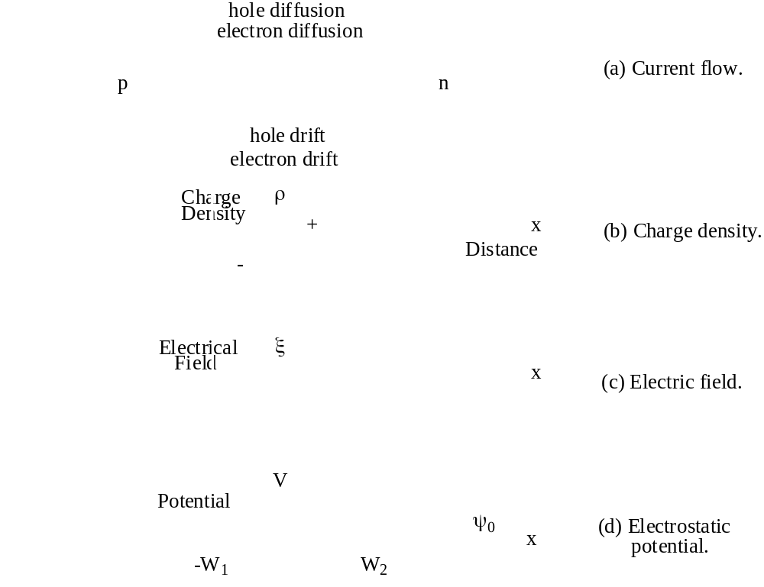
Depletion Region
Under Zero Bias
M.E.Zaghloul

Slide 6
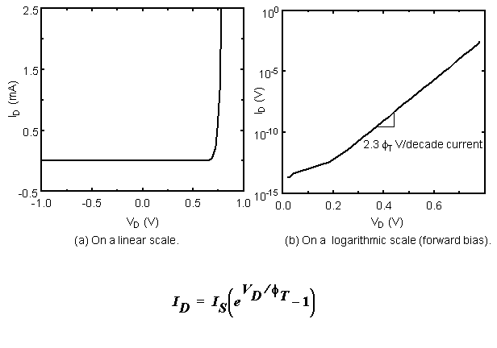
Diode Current
Ideal Diode Equation
Φ_{T} =KT/q
ф_{T} Thermal Potential
M.E.Zaghloul

Slide 7
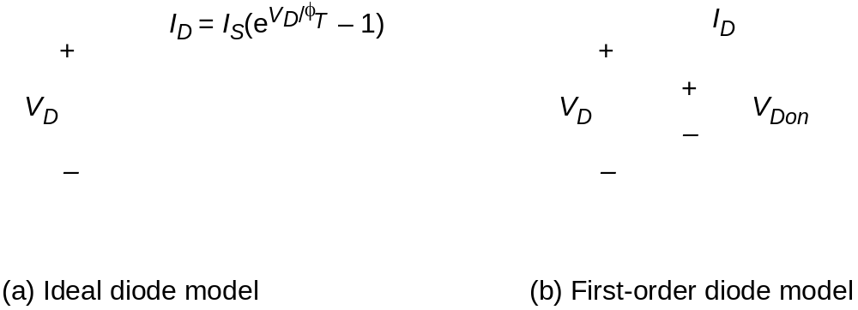
Models for Manual Analysis
M.E.Zaghloul

Slide 8
Most Of the CMOS IC
Diodes are reversed bias
Only under exceptional conditions they may be forward bias
We study diodes to understand that p-n junction involve capacitance called junction capacitance
M.E.Zaghloul

Slide 9

Junction Capacitor
It is possible to view the depletion region as a capacitance
The n- and p- act as capacitor plates
Using the charge voltage relation
V = C Q or C_{j} = dQ_{j} /dV_{D}
V_{D} is the bias voltage
M.E.Zaghloul

Slide 10
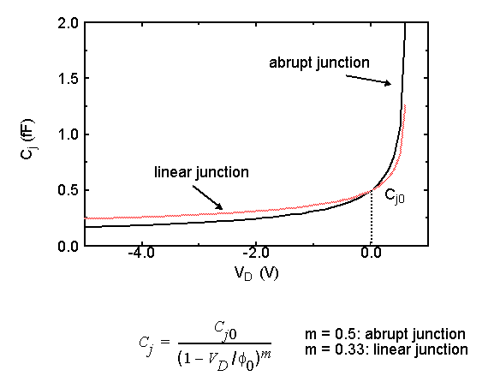
Junction Capacitance
Junction Capacitance at zero bias
Ф₀ built in Potential
M.E.Zaghloul

Slide 11
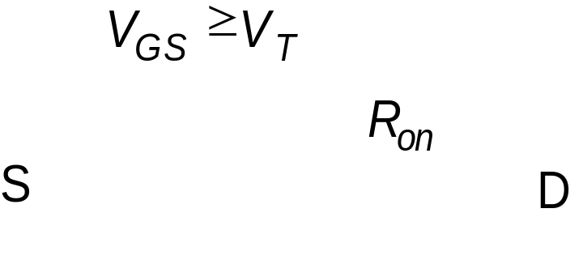

What is a Transistor?
S
D
A Switch!
An MOS Transistor
M.E.Zaghloul

Slide 12
MOS Transistor
Two Types n-MOS, and p-MOS
Four terminal device, Source, Drain, Gate , and Substrate
Symbols for n-MOS and p-MOS transistors ( Circuit Symbols)
M.E.Zaghloul

Slide 13
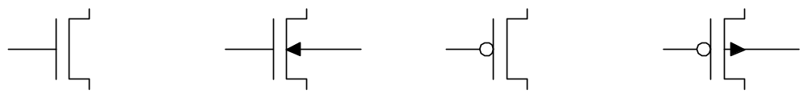
So far, we have treated transistors as ideal switches
An ON transistor passes a finite amount of current
  Depends on terminal voltages
  Derive current-voltage (I-V) relationships
Transistor gate, source, drain all have capacitance
  Capacitance and current determine speed
3: CMOS Transistor Theory

Slide 14
N-MOS Enhancement Transistor
Moderately doped p-type silicon substrate
The Source and Drain are heavily doped n⁺ regions
Channel is between the two regions
The following section review the operation of the N-MOS Transistor
M.E.Zaghloul

Slide 15
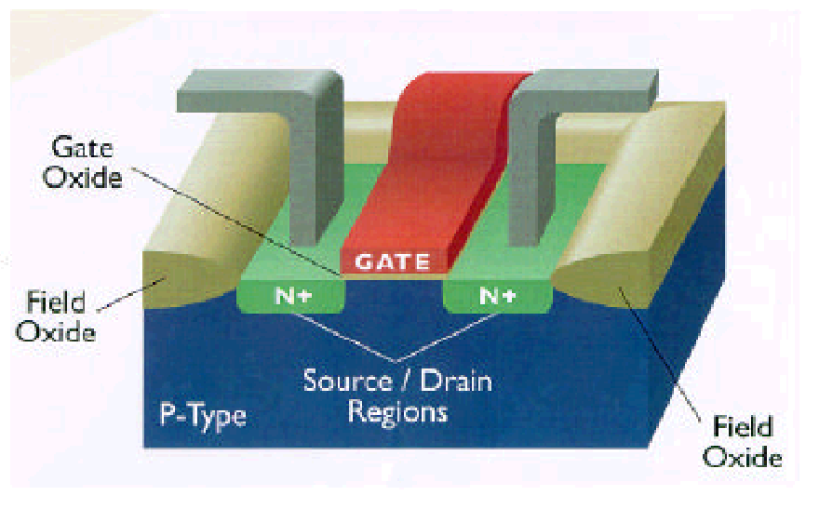
The MOS Transistor
Polysilicon
Aluminum

Slide 16
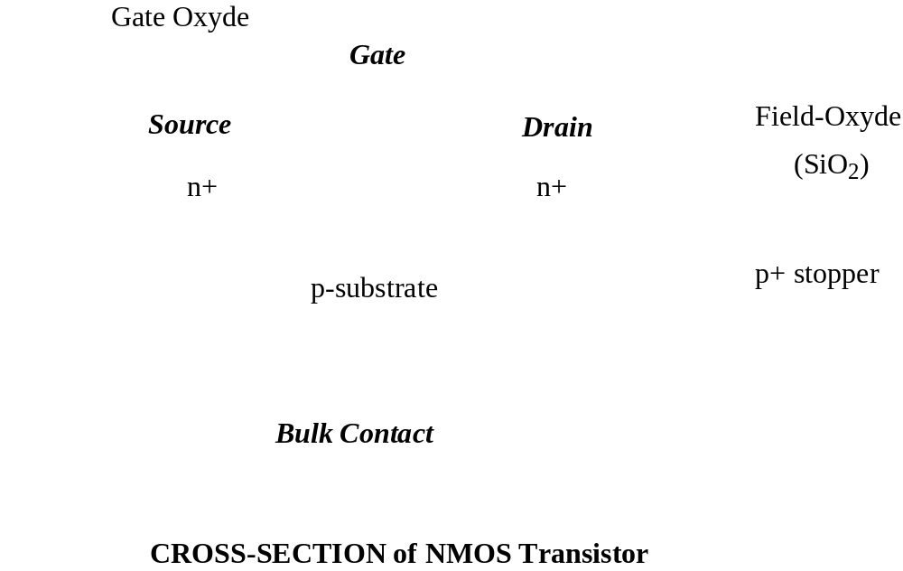
The MOS Transistor
Side View
M.E.Zaghloul

Slide 17
NMOS Behavior
Three Region of Operation:
Cut-Off almost zero current flows as gate voltage to source is less than threshold voltage
Non-saturated region, the drain current is linearly depending on the drain voltage
Saturated region the channel is strongly inverted and the drain current is independent from the drain voltage
M.E.Zaghloul

Slide 18
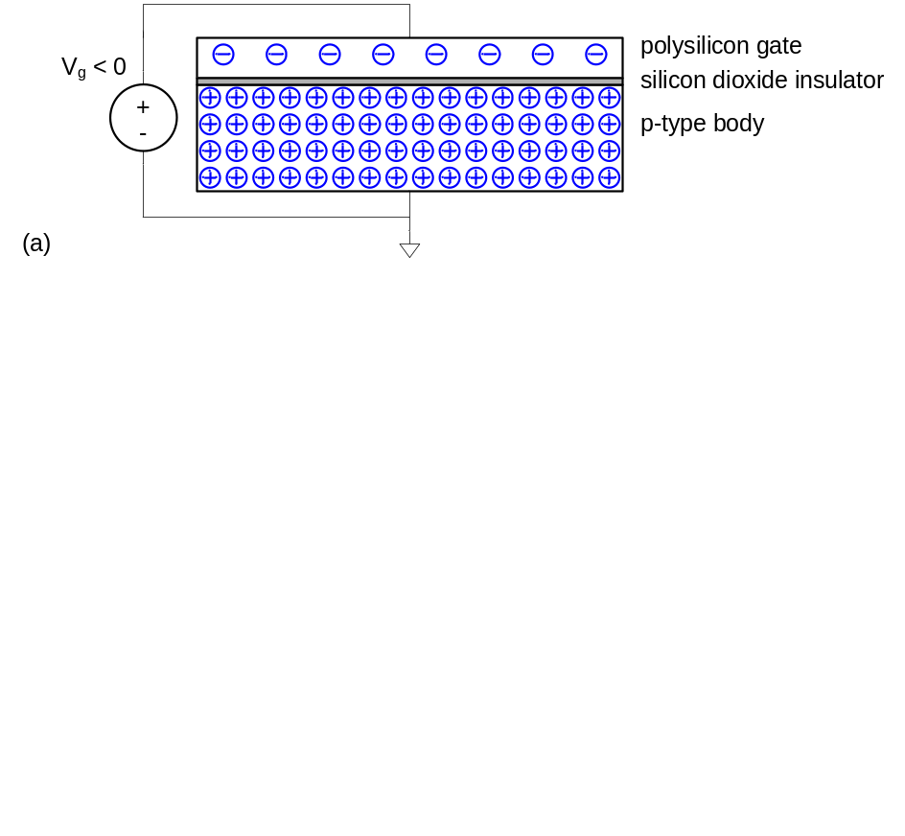
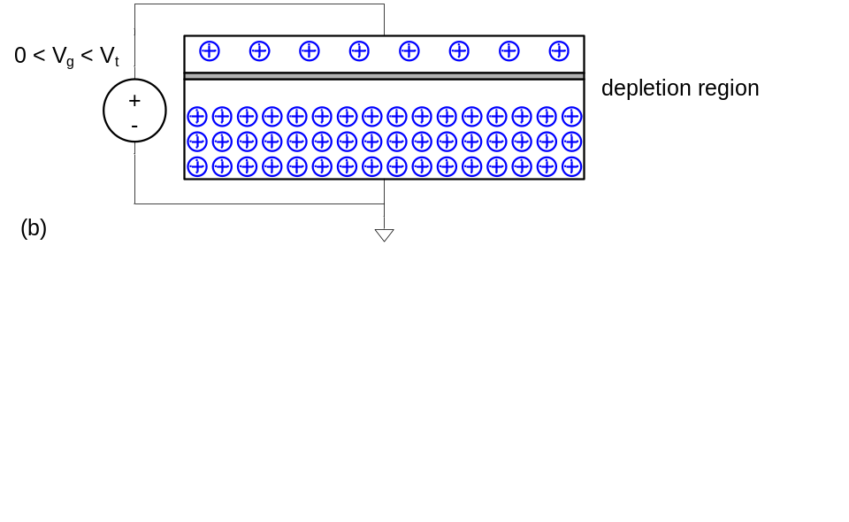
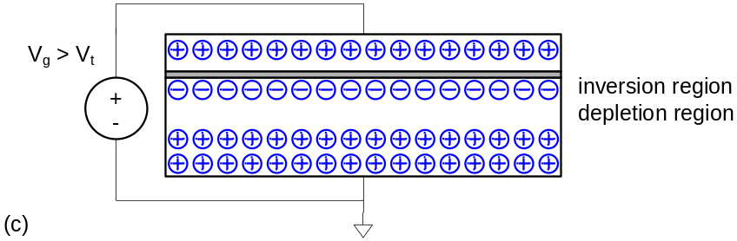
MOS Capacitor
Gate and body form MOS capacitor
Operating modes of transistors
  Accumulation
  Depletion
  Inversion
3: CMOS Transistor Theory

Slide 19
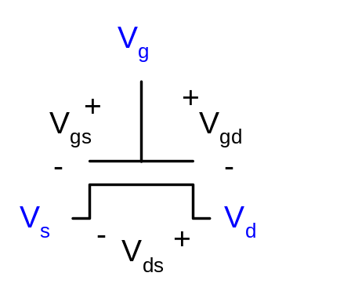
Terminal Voltages
Mode of operation depends on V_{g}, V_{d}, V_{s}
  V_{gs} = V_{g} – V_{s}
  V_{gd} = V_{g} – V_{d}
  V_{ds} = V_{d} – V_{s} = V_{gs} - V_{gd}
Source and drain are symmetric diffusion terminals
  By convention, source is terminal which is at lower voltage
nMOS body is grounded. First assume source is 0 too.
Three regions of operation
  Cutoff
  Linear
  Saturation
3: CMOS Transistor Theory

Slide 20
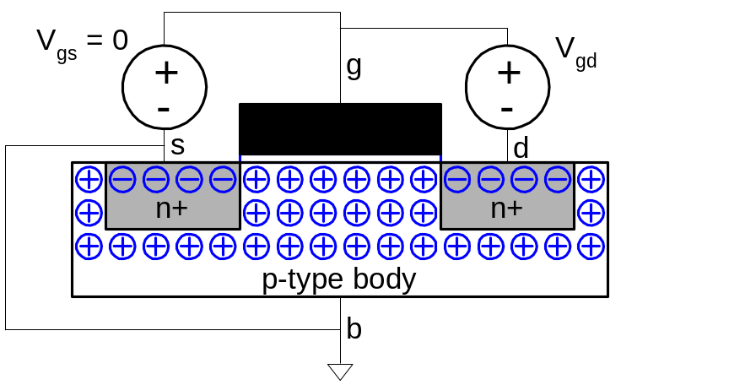
nMOS Cutoff
No channel
I_{ds} ≈ 0
3: CMOS Transistor Theory

Slide 21
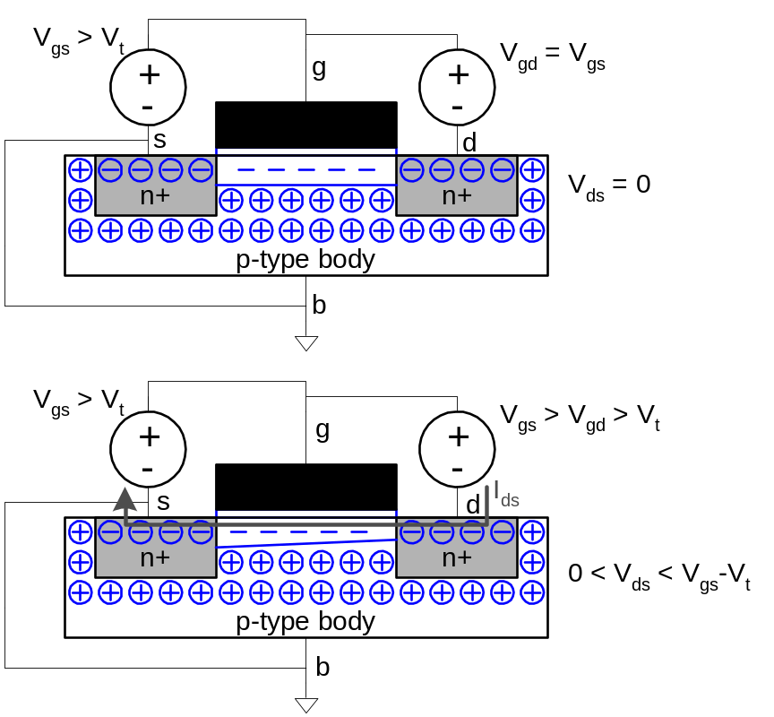
nMOS Linear
Channel forms
Current flows from d
to s
  e⁻ from s to d
I_{ds} increases with V_{ds}
Similar to linear resistor
3: CMOS Transistor Theory

Slide 22
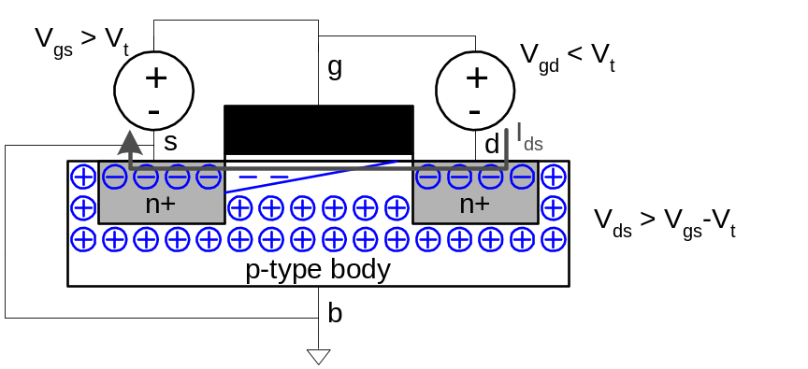
nMOS Saturation
Channel pinches off
I_{ds} independent of V_{ds}
We say current saturates
Similar to current source
3: CMOS Transistor Theory

Slide 23
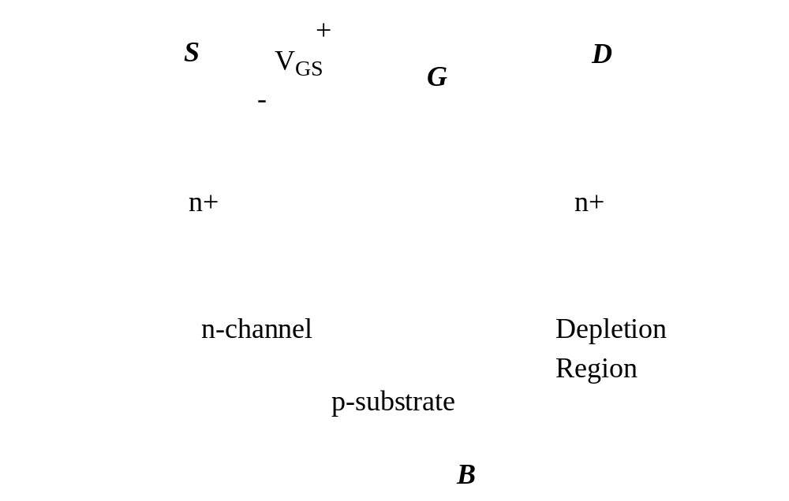
Threshold Voltage: Concept
Transistor Source have 0 bias
If V_{GS}= 0, Drain, Source, Bulk are connected to ground
M.E.Zaghloul

Slide 24
I-V Characteristics
In Linear region, I_{ds} depends on
  How much charge is in the channel?
  How fast is the charge moving?
3: CMOS Transistor Theory

Slide 25
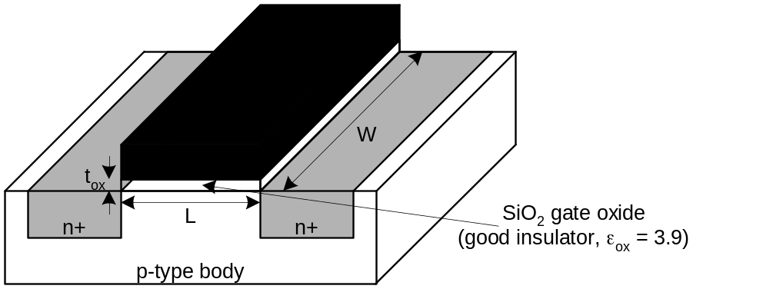
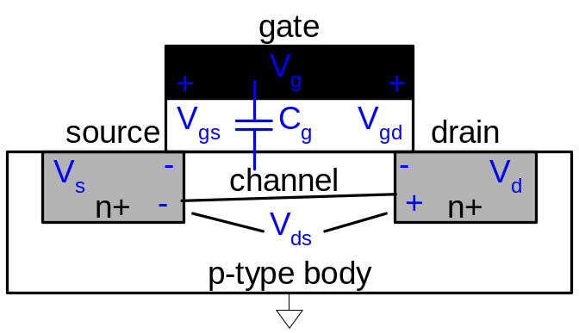
Channel Charge
MOS structure looks like parallel plate capacitor while operating in inversions
  Gate – oxide – channel
Q_{channel} = CV = C_{g} (V_{gc} – V_{t} )
C = C_{g} = ε_{ox}WL/t_{ox} = C_{ox}WL
C_{ox} = ε_{ox} / t_{ox}
3: CMOS Transistor Theory

Slide 26
nMOS Linear I-V
Now we know
  How much charge Q_{channel} is in the channel
  How much time t each carrier takes to cross
  The time required for Carriers to cross the channel is L/v, Lis channel length, v is carrier velocity
  Carrier velocity v=μ E, μ is the mobility
  E is the electric field, which is voltage between source and drain E = V_{ds} / L
  Follow the derivation Page 86 Weste,Harris
3: CMOS Transistor Theory

Slide 27
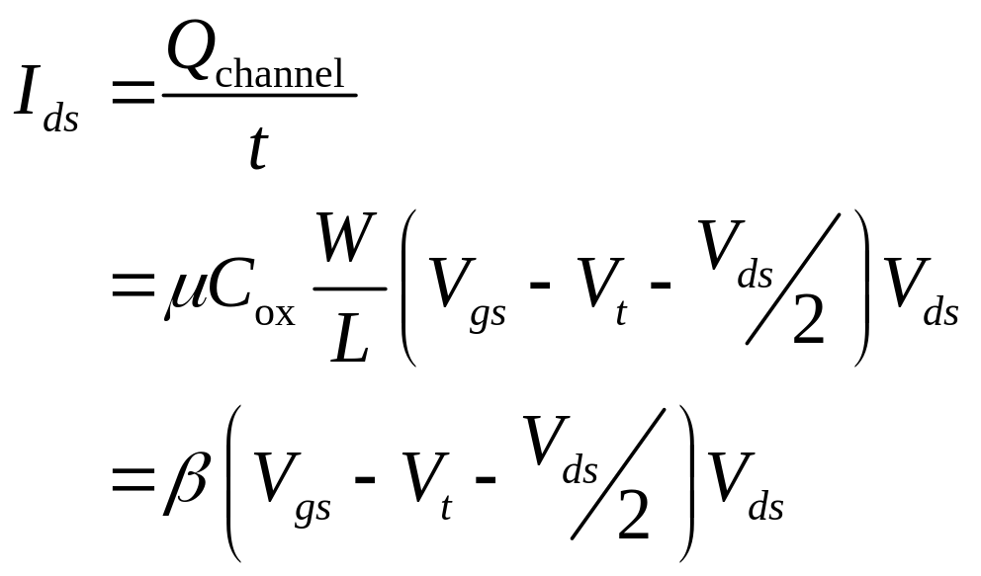
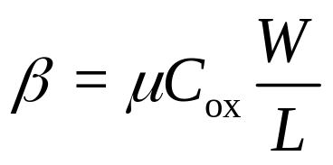
nMOS Linear I-V
M.E.Zaghloul

Slide 28
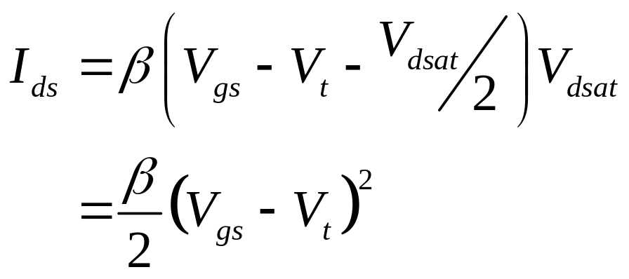
nMOS Saturation I-V
If V_{gd} < V_{t}, channel pinches off near drain
  When V_{ds} > V_{dsat} = V_{gs} – V_{t}
Now drain voltage no longer increases current
3: CMOS Transistor Theory

Slide 29
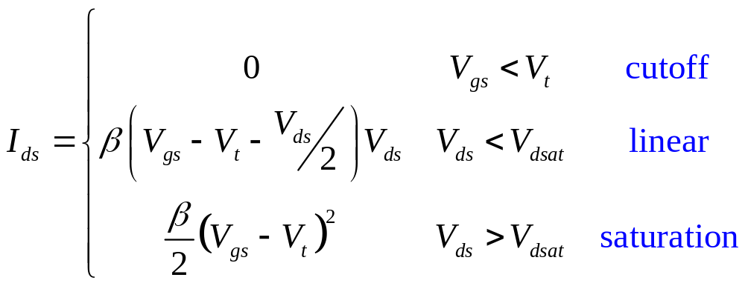
nMOS I-V Summary
Shockley 1st order transistor models
3: CMOS Transistor Theory

Slide 30
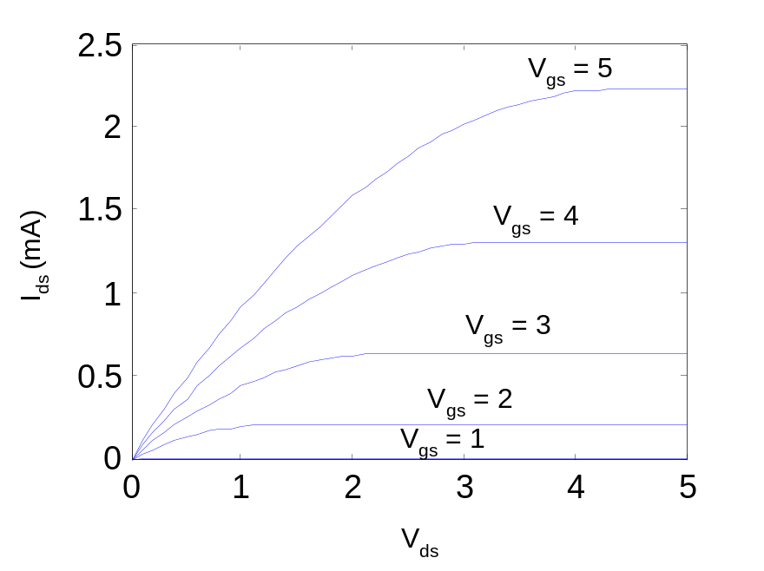
Example
We will be using a 0.6 μm process for your project
  From AMI Foundary parameters Semiconductor
  t_{ox} = 100 Å
  μ = 350 cm²/V*s
  V_{t} = 0.7 V
Plot I_{ds} vs. V_{ds}
  V_{gs} = 0, 1, 2, 3, 4, 5
  Use W/L = 4/2 λ
3: CMOS Transistor Theory

Slide 31
pMOS I-V
All dopings and voltages are inverted for pMOS
  Source is the more positive terminal
Mobility m_{p} is determined by holes
  Typically 2-3x lower than that of electrons m_{n}
  120 cm²/V•s in AMI 0.6 mm process
Thus pMOS must be wider to
provide same current
  In this class, assume
  m_{n} / m_{p} = 2
3: CMOS Transistor Theory

Slide 32
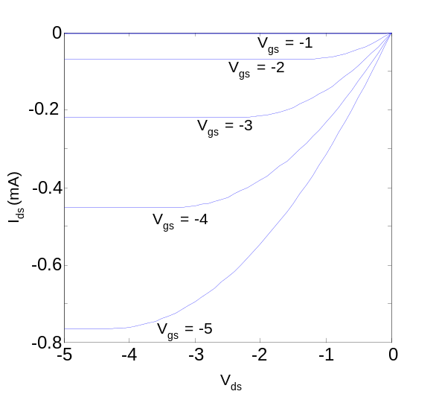
pMOS I-V
M.E.Zaghloul

Slide 33
pMOS I-V
All dopings and voltages are inverted for pMOS
  Source is the more positive terminal
Mobility μ_{p} is determined by holes
  Typically 2-3x lower than that of electrons μ_{n}
  120 cm²/V•s in AMI 0.6 μm process
Thus pMOS must be wider to
To provide same current
In this class, assume
  μ_{n} / μ_{p} = 2
3: CMOS Transistor Theory

Slide 34
Transistor Operation
Assume that a positive voltage is applied to the gate w.r.t.source
The gate and the substrate form two plates capacitor with gate oxide as dielectric
The positive gate voltage causes positive and negative charges to accumulate on the gate electrode and the substrate depletion region
As the gate voltage increases strong inversion layer, the value of V_{GS} is called threshold voltage V_{T}
M.E.Zaghloul

Slide 35
The Threshold Voltage Formula
Threshold Voltage is determined by
The doping concentration
The insulator material
The substrate potential
M.E.Zaghloul

Slide 36
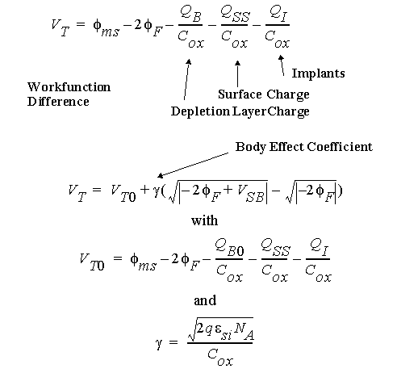
The Threshold Voltage
Body Effect coefficient
M.E.Zaghloul

Slide 37
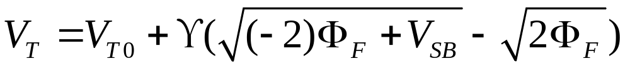
The Threshold Voltage Formula
Numerical Formula
Threshold at Zero bulk potential
Body Effect Coefficient
M.E.Zaghloul

Slide 38
Threshold Voltage
It is a function of several parameters
Gate Material (poly) ( Fermi Potential)
Dielectric Constant of Thin Oxide (gate Oxide)
Thickness of the Thin Oxide.
C_{OX} = e_{OX} / t_{OX}
Channel Doping
Voltage between source and substrate V_{SB}
For Deep Submicron the threshold voltage is adjusted
M.E.Zaghloul

Slide 39
Threshold Voltage
N-MOS Threshold Voltage is > 0
P-MOS Threshold Voltage is < 0
M.E.Zaghloul

Slide 40
Body Effect
Two or more devices in Series
Vsb2 = 0
Vsb1 = 0
Common Bulk that is biased to Zero
M.E.Zaghloul

Slide 41
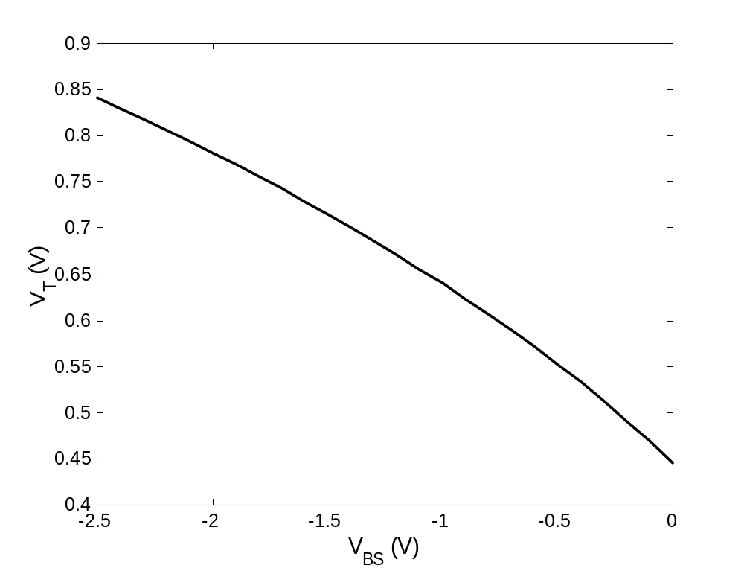
Well Bias Effect (NMOS)
Negative bias on the well causes V_{T} to increase
M.E.Zaghloul

Slide 42

BREAK
M.E.Zaghloul

Slide 43
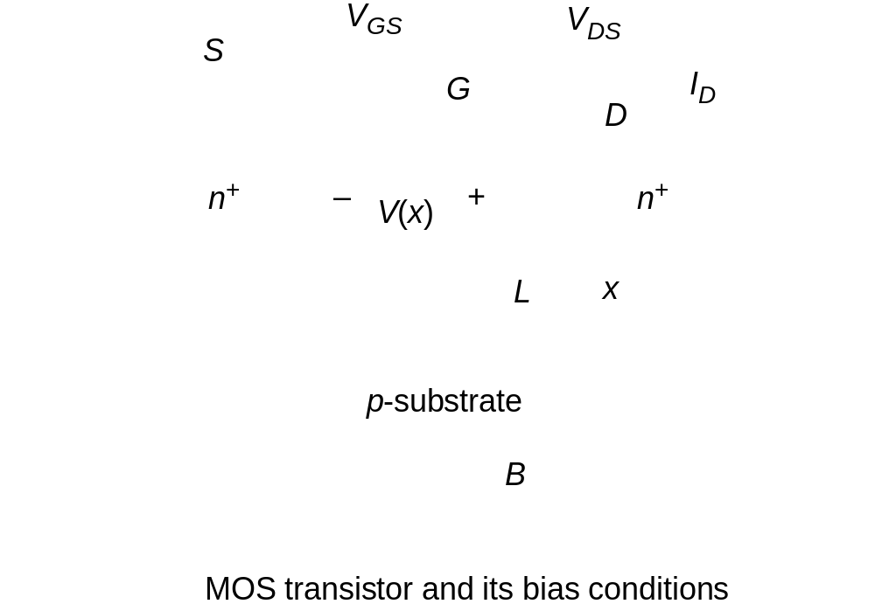
MOS Current-Voltage Relations
Assume that V_{GS} > V_{T} and small voltage V_{DS} are applied
M.E.Zaghloul

Slide 44
Transistor in Linear
M.E.Zaghloul

Slide 45
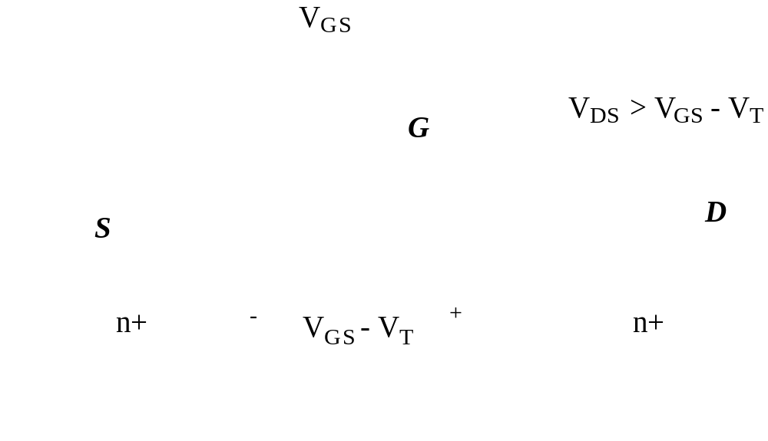
Transistor in Saturation
Pinch-off
M.E.Zaghloul

Slide 46
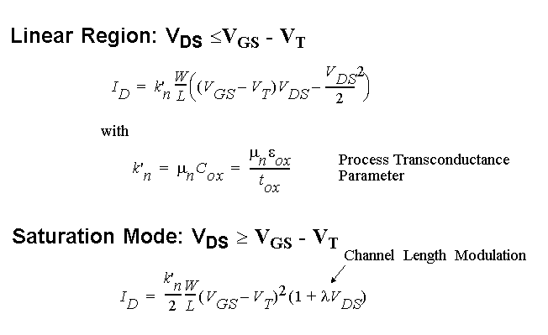
Current-Voltage Relations
Long-Channel Device
M.E.Zaghloul

Slide 47
Current-Voltage Relations
Long Channel
x 10
-4
6
VGS= 2.5 V
5
Resistive
Saturation
4
VGS= 2.0 V
(A)
3
Quadratic
Relationship
I
D
V_{DS} = V_{GS} - V_{T}
2
VGS= 1.5 V
1
VGS= 1.0 V
0
0
0.5
1
1.5
2
2.5
V
DS
(V)
M.E.Zaghloul

Slide 48
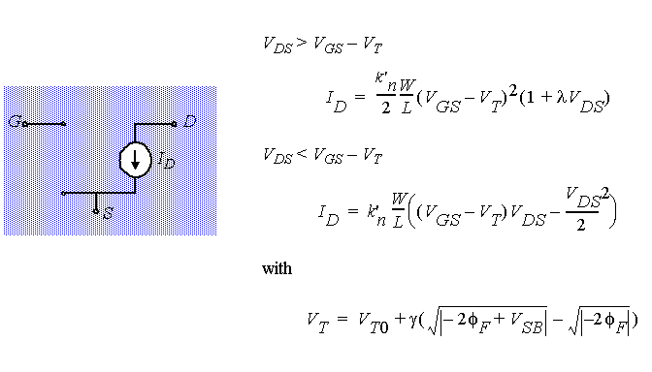
A model for manual analysis
M.E.Zaghloul

Slide 49
Current-Voltage Relations
The Deep-Submicron Era( Short Channel)
x 10
-4
2.5
Early Saturation
VGS= 2.5 V
2
VGS= 2.0 V
1.5
(A)
Linear
Relationship
I
D
VGS= 1.5 V
1
0.5
VGS= 1.0 V
0
0
0.5
1
1.5
2
2.5
V
DS
(V)
M.E.Zaghloul

Slide 50
Carriers Velocity V_{n}
The Carriers Velocity is related to the Electric Field
The carriers Velocity V_{n} = Mobility* Electric field, velocity is Proportional to Electric Field
The Electric field –Velocity relation is as shown
At High Electric Field this relation fails
M.E.Zaghloul

Slide 51
Perspective
Short channel device enters saturation before V_{GT}
I
D
Long-channel device
V
= V
GS
DD
Short-channel device
V
V
- V
V
DSAT
GS
T
DS
M.E.Zaghloul

Slide 52
Short Channel Device
The device enters saturation before V_{DS} reaches V_{GS} – V_{T}
Device tends to operate often in Saturation
The saturation current displays linear dependence with respect to V_{GS}
M.E.Zaghloul

Slide 53
I_{D} versus V_{GS}
-4
x 10
-4
6
2.5
x 10
5
2
linear
4
quadratic
1.5
(A)
3
(A)
I
D
I
D
1
2
1
0.5
quadratic
0
0
0.5
1
1.5
2
2.5
0
0
0.5
1
1.5
2
2.5
V
GS
(V)
V
GS
(V)
Long Channel
Short Channel
M.E.Zaghloul

Slide 54
I_{D} versus V_{DS}
-4
-4
6
x 10
2.5
x 10
VGS= 2.5 V
VGS= 2.5 V
5
2
Resistive
Saturation
4
VGS= 2.0 V
VGS= 2.0 V
1.5
(A)
3
(A)
I
D
V_{DS} = V_{GS} - V_{T}
I
D
VGS= 1.5 V
1
2
VGS= 1.5 V
1
0.5
VGS= 1.0 V
VGS= 1.0 V
0
0
0.5
1
1.5
2
2.5
0
0
0.5
1
1.5
2
2.5
V
DS
(V)
V
DS
(V)
Long Channel
Short Channel
M.E.Zaghloul

Slide 55
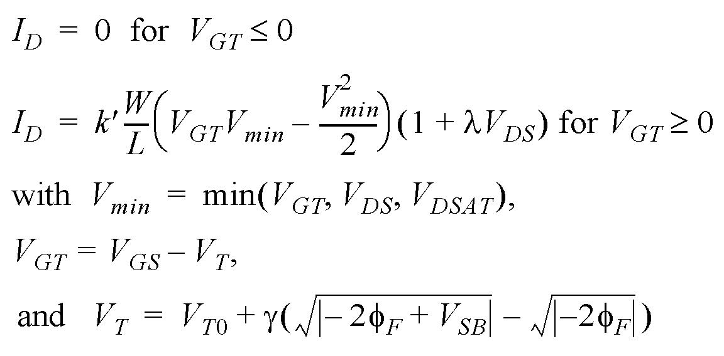
A unified model for Short Channel analysis
The effect will imply modified drain current resistive relation
G
S
D
B
M.E.Zaghloul

Slide 56
A PMOS Transistor
x 10
-4
0
VGS = -1.0V
-0.2
VGS = -1.5V
-0.4
(A)
I
D
VGS = -2.0V
Assume all variables
negative!
-0.6
-0.8
VGS = -2.5V
-1
-2.5
-2
-1.5
-1
-0.5
0
V
DS
(V)
M.E.Zaghloul

Slide 57
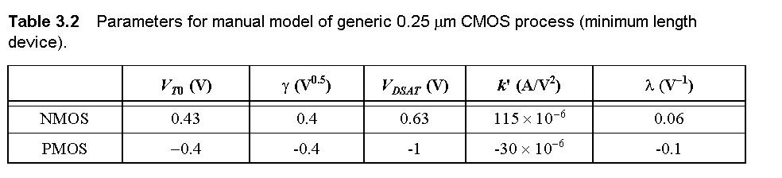
Transistor Model for Manual Analysis
M.E.Zaghloul

Slide 58
Sub Threshold Conduction
A closer inspection of I_{D} – V_{GS} curves shows that the current does not drop to zero below threshold voltage
Actually the current behaves exponential similar to bipolar
The effect is called subthreshold conduction
M.E.Zaghloul

Slide 59
Sub-Threshold Conduction
The current does not drop to zero when V_{GS} < V_{T}
but actually decays exponentially
10
-2
Linear
In most digital applications
The presence of subthreshold
Current is undesirable
10
-4
10
-6
Quadratic
(A)
I
D
10
-8
Exponential
10
-10
V_{T}
10
-12
0
0.5
1
1.5
2
2.5
V
GS
(V)
M.E.Zaghloul

Slide 60
The Transistor as a Switch
Equivalent Resistance of Transistor
Average Resistance of equivalent resistance
V_{DS}/ I_{DS}
M.E.Zaghloul

Slide 61
Equivalent Resistance of Transistor
The resistance is inversely proportional to W/L doubling transistor width cuts resistance in half
Once the supply voltage approaches V_{T} , the resistance dramatically increases
M.E.Zaghloul

Slide 62
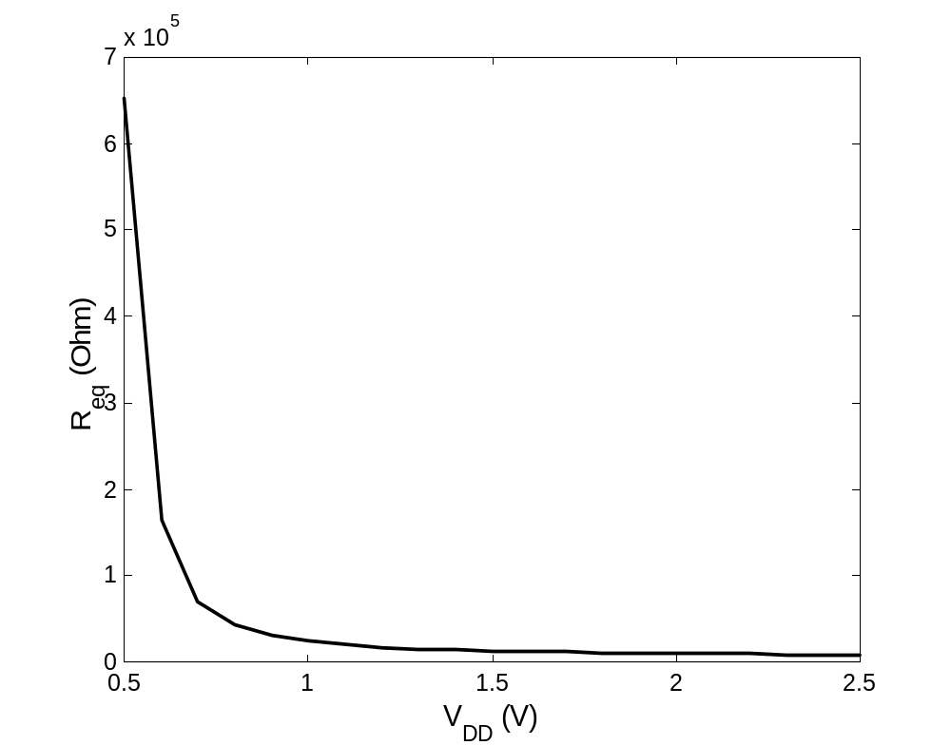
The Transistor as a Switch
M.E.Zaghloul

Slide 63
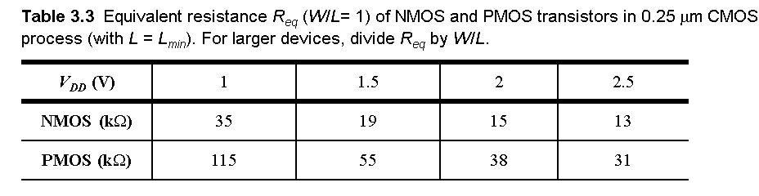
The Transistor as a Switch
M.E.Zaghloul

Slide 64
Summary of MOSFET Operating Regions
Strong Inversion V_{GS} > V_{T}
  Linear (Resistive) V_{DS} < V_{DSAT}
  Saturated (Constant Current) V_{DS} > V_{DSAT}
Weak Inversion (Sub-Threshold) V_{GS} < V_{T}
  Exponential in V_{GS} with linear V_{DS} dependence
M.E.Zaghloul

Slide 65
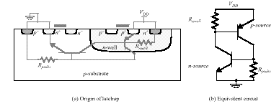
Latch-up ( short VDD-VSS)
Parasitic Transistors
N-Well Technology
M.E.Zaghloul

Slide 66
How to Avoid Latch-UP
Rules for Well layout
Every well should have at least one contact
All substrate and well contacts should be connected directly to the appropriate supply using metal wiring
Increase Well Contacts, should be placed every 5-10 transistors
NMOS transistors should cluster together near GND line, PMOS transistors should cluster together near VDD
You always design as if you have double wells process
M.E.Zaghloul

Slide 67
CMOS- Capacitances
Any two conductors separated by an insulator have capacitance
Gate to channel capacitor is very important
  Creates channel charge necessary for operation
Source and drain have capacitance to body
  Across reverse-biased diodes
  Called diffusion capacitance because it is associated with source/drain diffusion
3: CMOS Transistor Theory

Slide 68
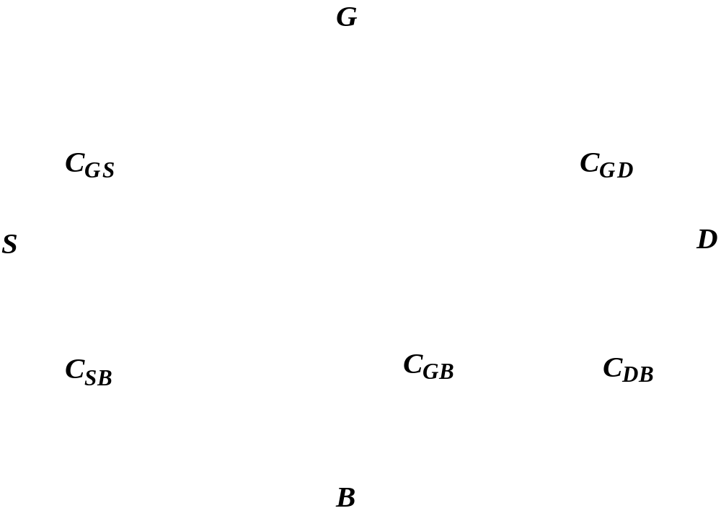
Dynamic Behavior of MOS Transistor

Slide 69
Gate Capacitance
Approximate channel as connected to source
C_{gs} = ε_{ox}WL/t_{ox} = C_{ox}WL = C_{permicron}W
C_{permicron} is typically about 2 fF/μm
3: CMOS Transistor Theory

Slide 70

M.E.Zaghloul

Slide 71
Diffusion Capacitance
C_{sb}, C_{db}
Undesirable, called parasitic capacitance
Capacitance depends on area and perimeter
  Use small diffusion nodes Comparable to C_{g}
  for contacted diff
  ½ C_{g} for uncontacted
  Varies with process
3: CMOS Transistor Theory

Slide 72
Dynamic Behavior of MOS Transistor
M.E.Zaghloul

Slide 73
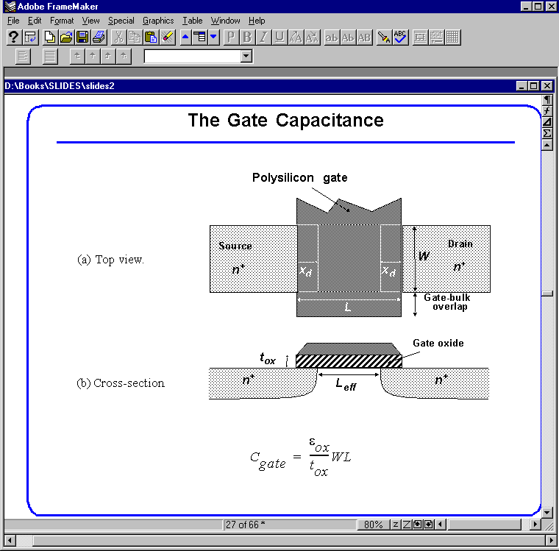
The Gate Capacitance
Polysilicon gate
Source
Drain
W
n
+
x
d
x
d
n
+
L
Gate-bulk
d
overlap
Top view
Gate oxide
t
ox
n
+
L
n
+
Cross section
M.E.Zaghloul

Slide 74
The Gate Capacitance
M.E.Zaghloul

Slide 75
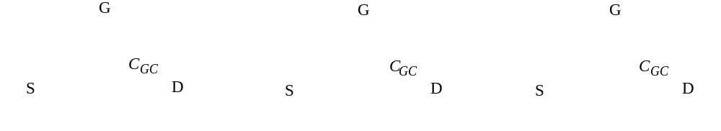
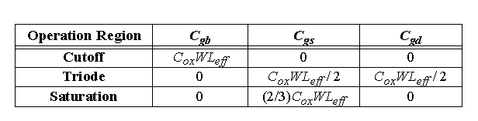
Gate Capacitance
Cut-off
Resistive
Saturation
Most important regions in digital design: saturation and cut-off
M.E.Zaghloul

Slide 76

Diffusion Capacitance
Channel-stop implant
N
A
1
Side wall
W
Source
N
D
Bottom
x
j
Side wall
Channel
L
S
Substrate
N
A
M.E.Zaghloul

Slide 77
Junction Capacitance
M.E.Zaghloul

Slide 78
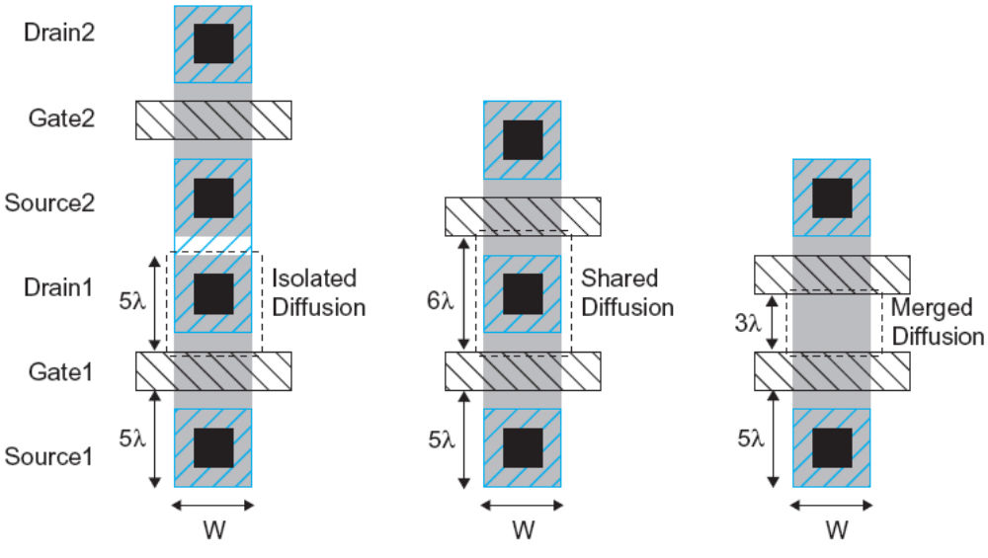
How to minimize parasitic capacitances
M.E.Zaghloul

Slide 79
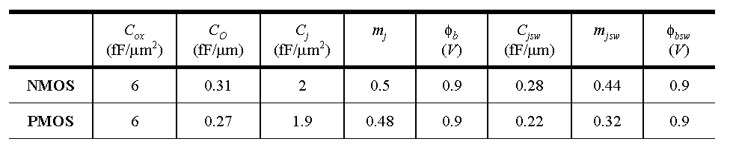
Capacitances in 0.25 μm CMOS process
M.E.Zaghloul

Slide 80
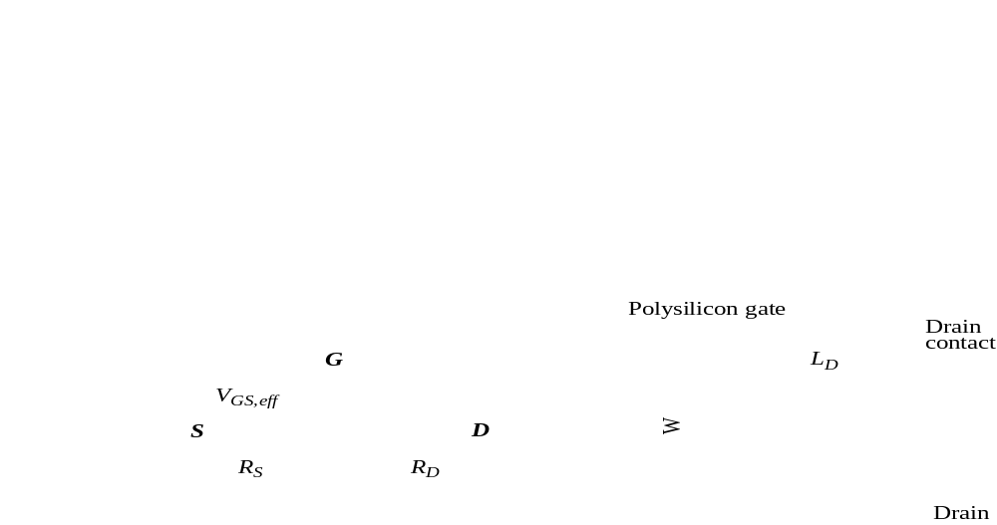
Parasitic Resistances
M.E.Zaghloul

Slide 81
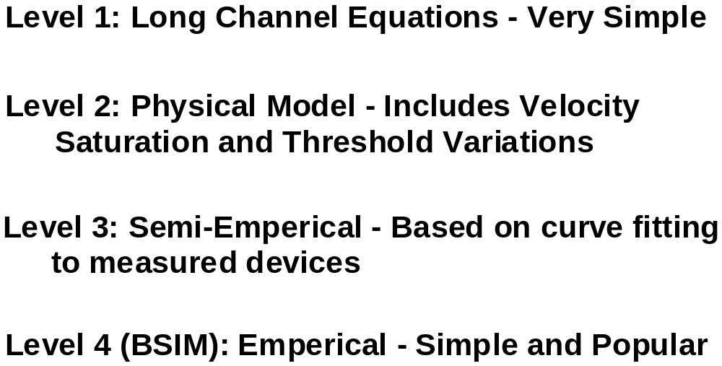
SPICE MODELS
M.E.Zaghloul

Slide 82
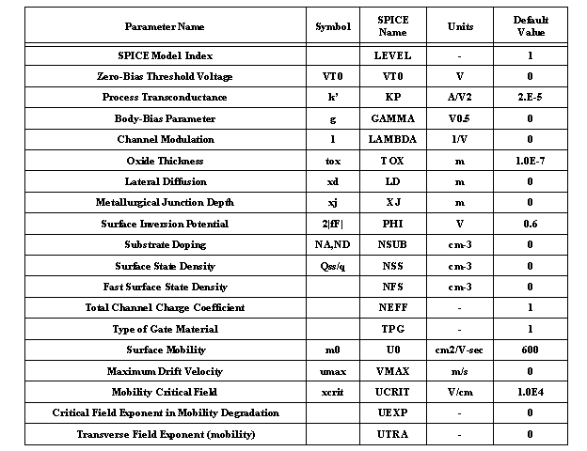
MAIN MOS SPICE PARAMETERS
M.E.Zaghloul

Slide 83
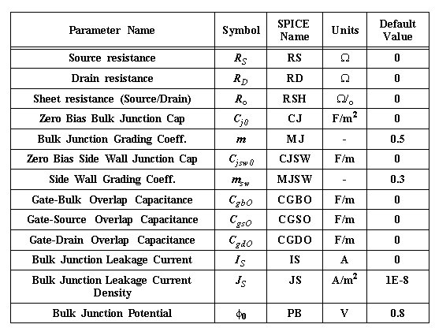
SPICE Parameters for Parasitic
M.E.Zaghloul

Slide 84
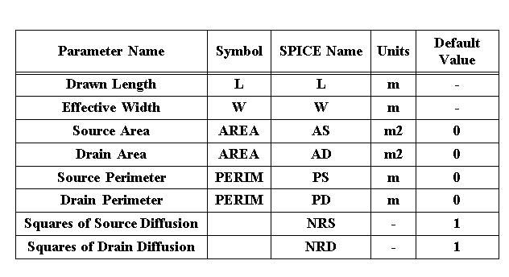
SPICE Transistors Parameters
M.E.Zaghloul

Slide 85
Techniques to Move to Nano Scale
Several techniques were proposed recently to move to the Nano scale dimensions
In the following we will mention some of these techniques
M.E.Zaghloul

Slide 86
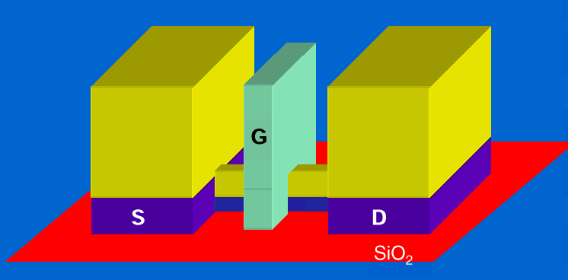
Nano Perspectives
FINFET gate
25 nm FINFET MOS transistor
M.E.Zaghloul

Slide 87
Intel New Transistor Device
Semiconductor Industry is Following what is known as Road Map.
What is the technical capabilities to be developed for the industry to stay on Moore Law and beyond.
International Semiconductor Industries such as Japan, Korea, Taiwan, Europe, and the U.S.
http://www.itrs.net/
M.E.Zaghloul

Slide 88
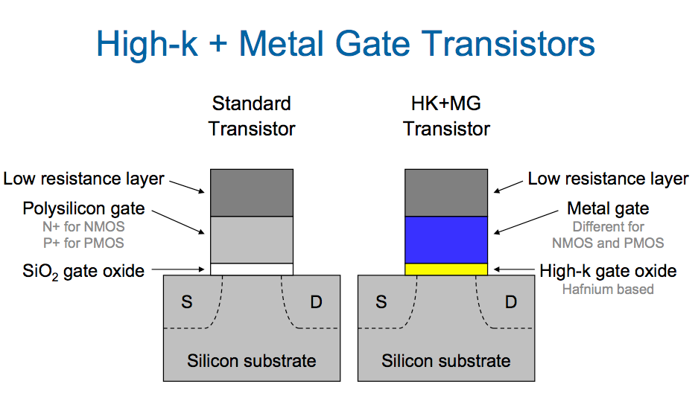
Intel Metal Gate Transistor
M.E.Zaghloul

Slide 89
This helped in the Continuity of Moore Law, not in the near future
Reduce Leakage at the nanoscale.
High K allows the reduction of leakage about 20x
Increase Drain current
In the old thin Oxide transistors, thin layer of depleted layer at bottom of the polysilicon, resulting in increase in the effective thickness of the thin oxide tox
M.E.Zaghloul

Slide 90
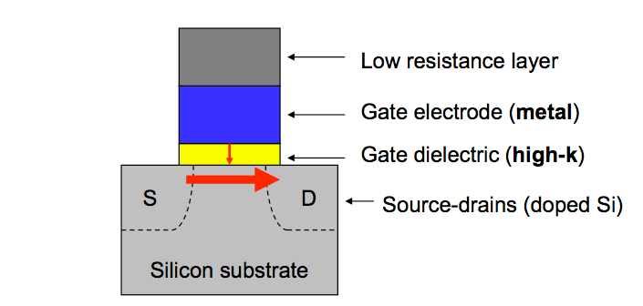
Converting the gate to Metal eliminates the depletion of the gate and thus increase the gate field effect and increase the On current and decrease the OFF current.
Converting the Si O2 to high –K dielectric allows using thicker dielectric layer , and significantly reduce leakage
M.E.Zaghloul

Slide 91
Intel New Metal gate Transistor
This allows production at 45 nm scale, and going to 22nm
Intel multi core Processors designs at high performance and high energy saving.
New power management design techniques to reduce energy
New micro-architecture design techniques
Intel Achieved Significant improvement in the design of transistors.
This is the biggest change in Transistors technology since 1960
M.E.Zaghloul

Slide 92
Designing Reliable Transistors The challenge of Second Order Effect
Channel Length Modulation, due to variation in V_{ds}
Mobility Variation both hole and electron decreases with doping concentration and varies with temperature
Temperature effects, mobility, and Threshold
Parameters Variations in production in the size of L and W it is possible to find the unit variation by one to two factors
Hot Electron as the length of the gate decrease the electric field at the drain increases. If it is high to cause the electrons to leave silicon and tunnel into gate oxide causing substrate current. The effect is threshold voltage increase in NMOS
M.E.Zaghloul

Slide 93
Threshold variations
As the device dimensions are reduced Threshold voltage becomes function of L,W, and V_{DS}
Threshold voltage decreases with L
Similar Threshold voltage decreases with V_{DS}
M.E.Zaghloul

Slide 94

Process Variations
M.E.Zaghloul

Slide 95

Impact of Device Variations
M.E.Zaghloul

Slide 96
Perspective
The minimum channel length is projected to continue beyond 22nm to 5-6 nm
More than billion transistors on die
Multi-Core Processors with complex functions and parallel capabilities
Beyond this scaling will not be easily established
M.E.Zaghloul

